Slide 1
Cat Food Dispenser
Sergio Perez-Aponte
Cop 5611 - OS design principles

Slide 2
Motivation
Since I spend more time at home, I have notice that my cat is eating more frequently but small quantity. It seems he is looking for me to pay more attention than normal by doing this. Now that I am starting to go to the office more frequently, I was looking a way to keep me well feed while I am out.

Slide 3
Introduction
Smart food dispenser for pets.
Only work for cats
Dispense a cup of food
Use a PIR motion sensor to trigger the object detection
TensorFlow Lite and OpenCV use for object detection
When detect a cat trigger the motor
After food dispense sleep for 10 minutes
Notes:
The motion sensor is Passive Infrared (PIR) that detect body heat this done by detecting changes in temperatures.
Step motor are use when pression is need it. It moves one step at the time.

Slide 4
Parts
Rapsberry pi 4 8GB
Pi camera
PIR motion sensor
Nema 17 stepper motor
DVR8825 stepper motor driver
DC power jack adapter
12v 500mA power source

Slide 5
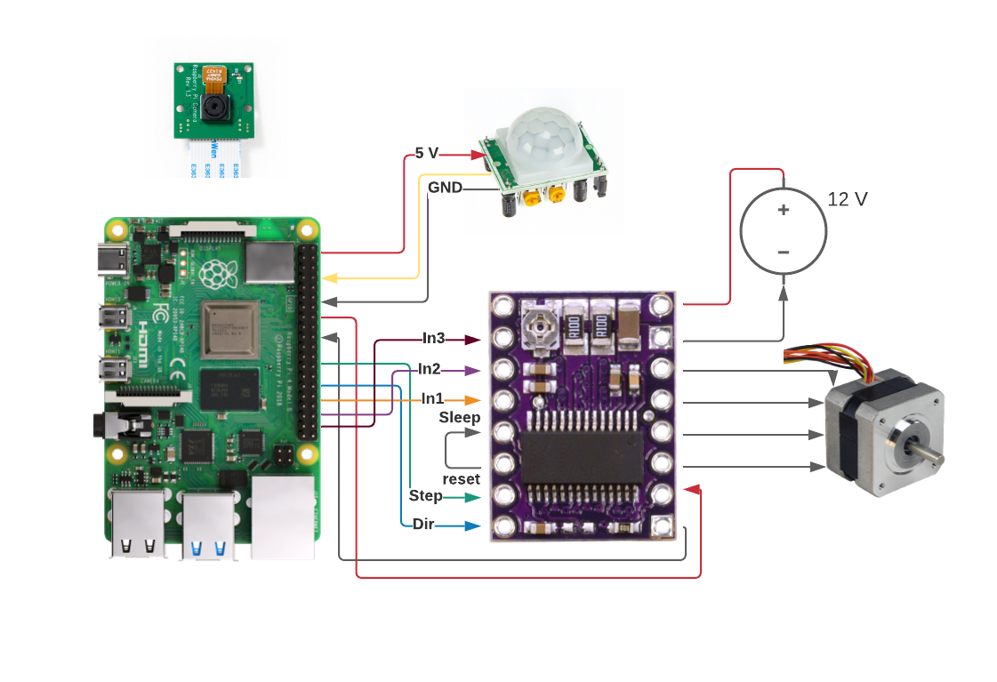
Hardware Diagram

Slide 6
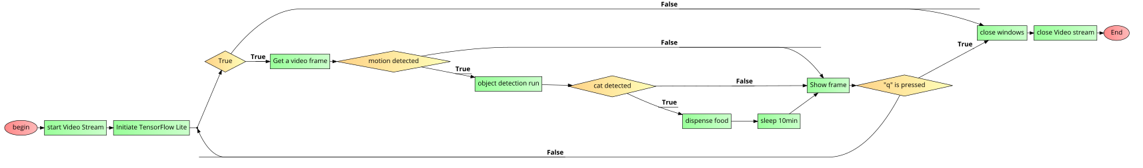
Software Diagram

Slide 7
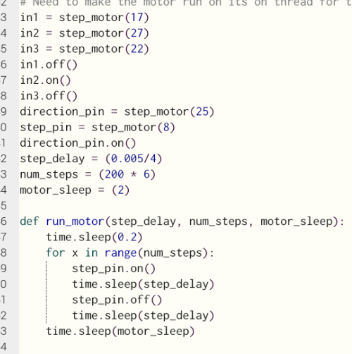
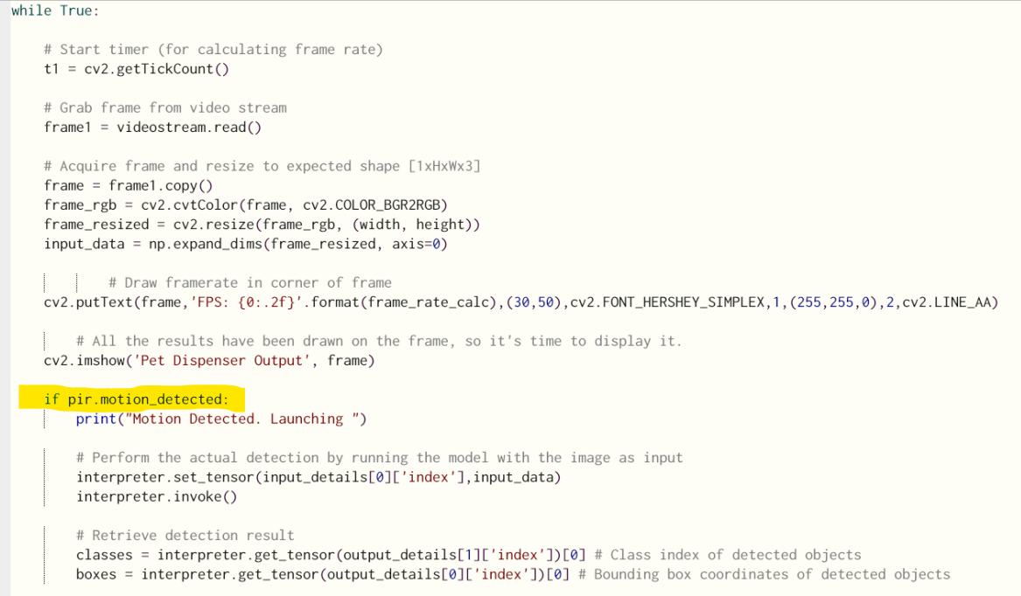
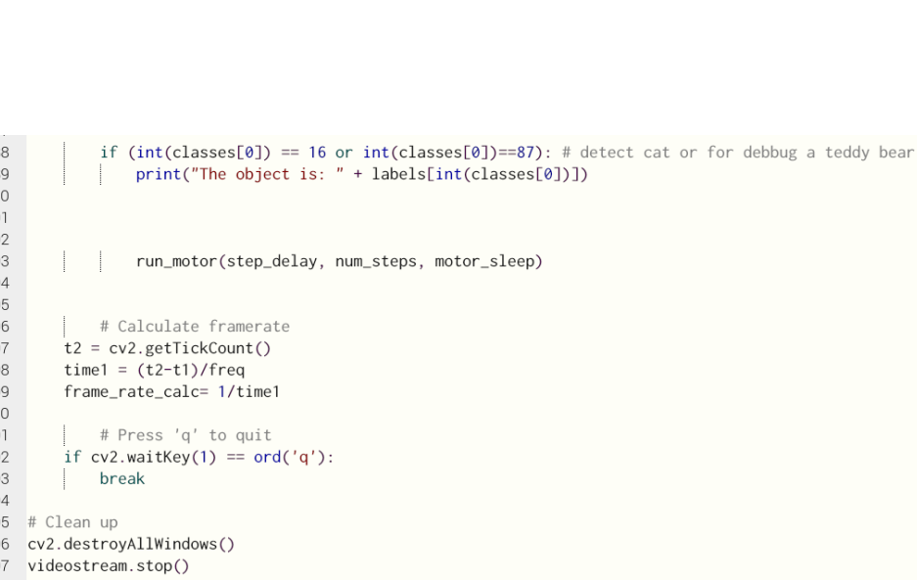
Code Snip

Slide 8
Road Blocks
Delivery delays
Problem with motors
Selected a motor with low torque
New motor uses different voltage, driver and different initialization

Slide 9
Future Improvement
Design a better body
Phone app
Choose between cat or dog
Select cup size from list
Stream video
Add a speaker to let user to speak
Option to let user dispense from phone

Slide 10

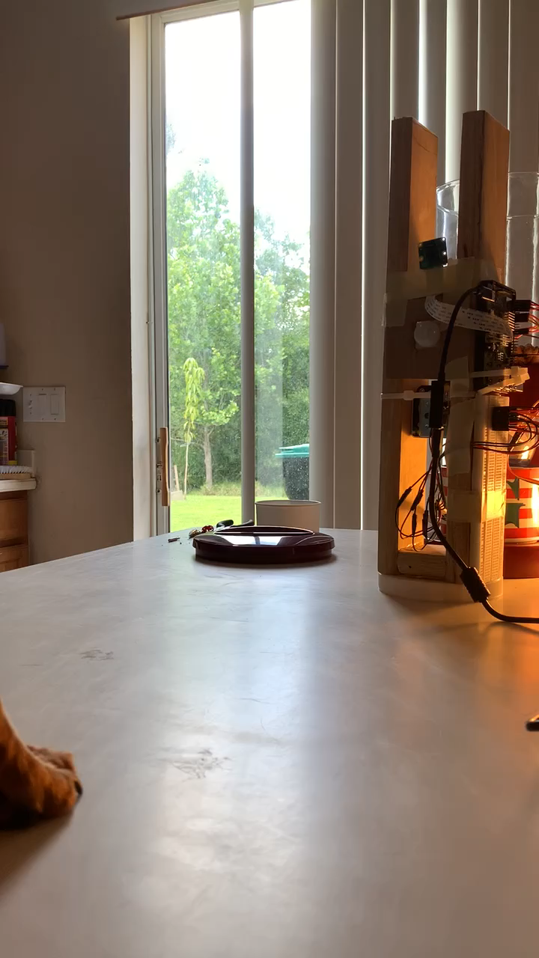
Demo

Slide 11
Questions?

